Slide 1
ENSE 470, Milestone 7
Team Eh
Quinn Bast, Nick Schmidt, Abdulaziz Alghamdi
April 12, 2018

Slide 2
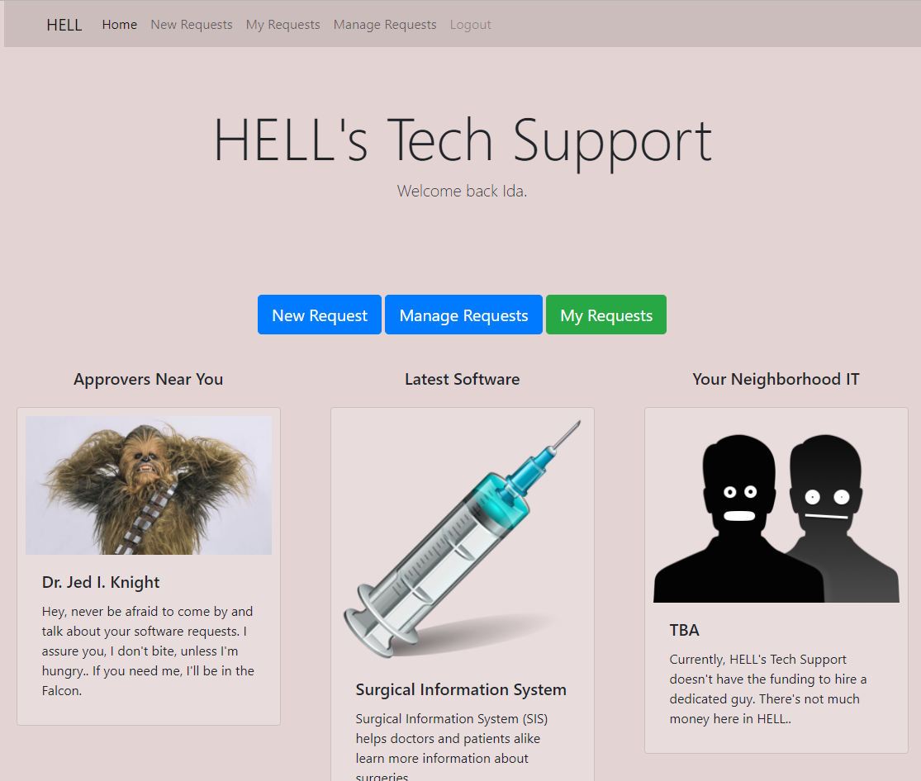
Introduction

Slide 3
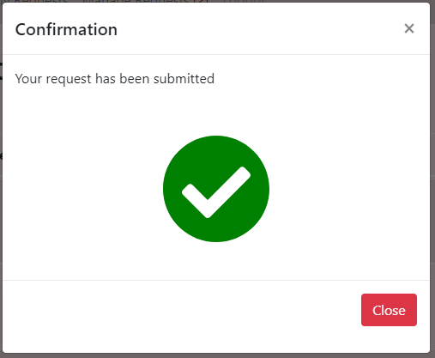
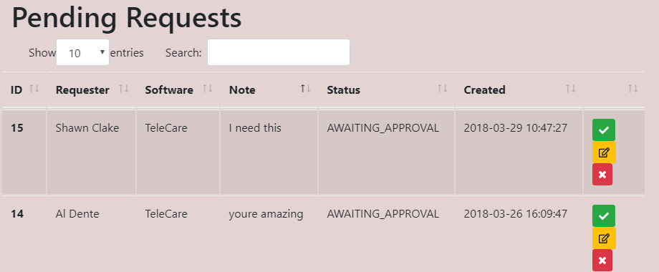
UI Review
Pros:
Fairly clean interface with minimal clutter.
Easily able to understand how to use and interact with the interface

Slide 4
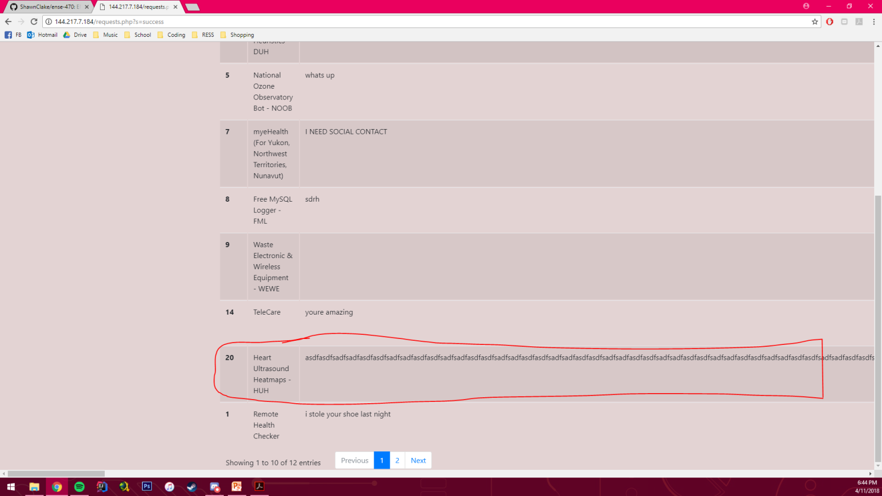
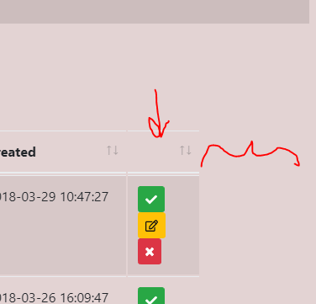

UI Review
Cons:
Buttons increase table size but extra space is available
Some minor UI bugs/glitches with buttons and large text fields

Slide 5
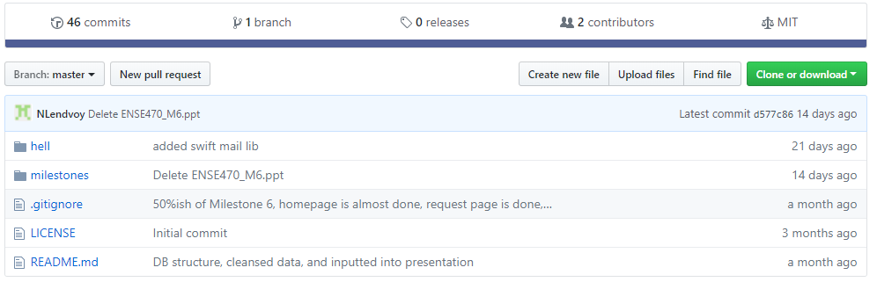
Team GitHub review
Github is readable and well organized.
Code is split up nicely into DB and SRC folders and each milestone has its own folder
Does the team provide good documentation?
Readme has not been updated since milestone 4
Would your team be able to easily and quickly pick up where they left off?
Yes, modifying their code would be easy given the excellent layout

Slide 6
Code review (High-level focus)
Is the team’s code obvious/readable for other programmers
Most of the code is easy enough to understand and follow
However, there are ZERO comments which make more complex files difficult to read
Do all tests pass?
ATDD tests are in Milestone 5, all ATDD tests from Milestone 5 are passing.
Code smells
Lack of comments
Their inputs are not sanitized
We could have dropped their tables but we are nice :)
Should probably refactor with mysqli_real_escape_string
Duplicate code in the manage.php file
Identical code except for one line in each Modal definition. Modal could be its own class.
Suggested refactor by “Replace method with object”

Slide 7
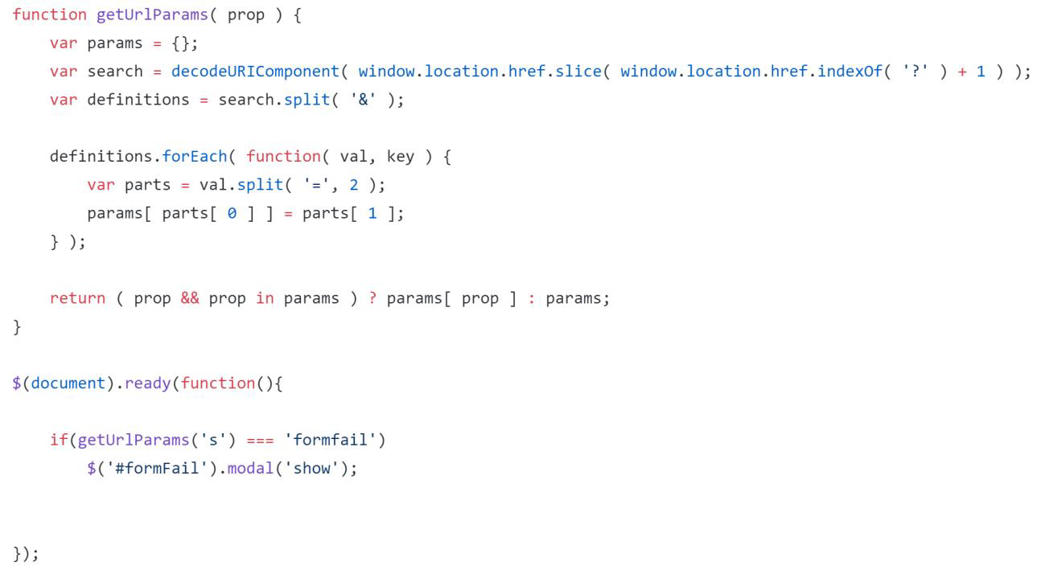
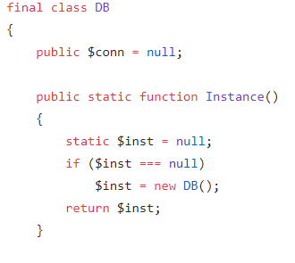
Design pattern discussion
Singleton was used on the database connection
Composite was used to display success and failure Modals
Model was used through the use of MySQL in the backend to store the data
Singleton
Composite

Slide 8

Reviewed team’s response
Questions or comments from Hell’s Tech Support?

Slide 9

Group reflection
How did you feel about this milestone? What did you like about it? What did you dislike?
This milestone was unique and an interesting way for each team to get feedback on their project
What did you learn about yourself as you collaborated and worked through this milestone?
It's quite a bit of fun trying to break other people's code
How will you use what you have learned going forward?
This technique of peer editing will become more useful as we move on to the work place.
What “stuff & things” related to this milestone would you want help with?

